Slide 1
Deep Neural Network
AIML Module 2
Seetha Parameswaran
BITS Pilani

Slide 2
The author of this deck, Prof. Seetha Parameswaran, is gratefully acknowledging the authors who made their course materials freely available online.

Slide 3
Artificial Neural Network

Slide 4
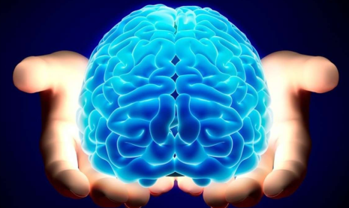
How do Humans Learn?
It begins with human brain.
Humans learn, solve problems, recognize patterns, create, think deeply about something, meditate and many many more.....
Humans learn through association. [Refer to Associationism for more details.]
Notes:
Human brain has the capability to learn, solve problems, recognize patterns, create, think deeply about something, meditate and many many more. We humans learn by observation. This is called as learning through association, in literature.

Slide 5
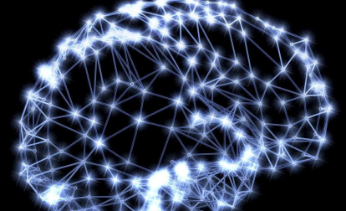
Observation: The Brain
The brain is a mass of interconnected neurons.
Number of neurons is approximately 10^(10).
Connections per neuron is approximately 10^(4 to 5).
Neuron switching time is approximately 0.001 second.
Scene recognition time is 1 second.
100 inference steps doesn't seem like enough. Lot of parallel computation.
Notes:
What is inside the brain? Neurons or neural units. Each unit is excited or fired or triggered based on the input it receives. When see an elephant or when we hear a sound, or smell maggi noodles, some of the neurons are excited and they get fired. Note that only those neurons that respond to smell of maggi noodles get fired. Others are inactive. These neurons that respond to smell, will get fired, and each neuron will produce or generate an apt response that can trigger some actions for the other parts of body like responding with words yummy!!!!

Slide 6
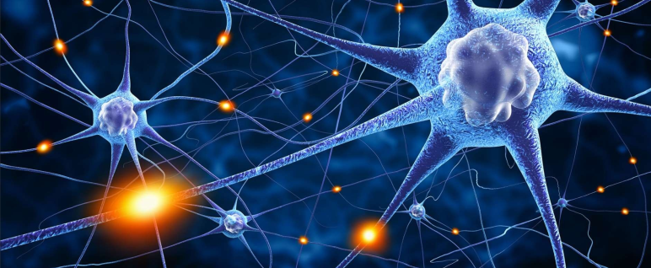
Brain: Interconnected Neurons
Many neurons connect in to each neuron.
Each neuron connects out to many neurons.
Notes:
The neurons in brain are interconnected to a lot of other neurons. The interconnections between the biological neurons are many and varied. Each neuron may receive stimulus from many other neurons. Each neurons will send responses to many other neurons. Even loops between neurons and self loops can be seen among these neurons.

Slide 7
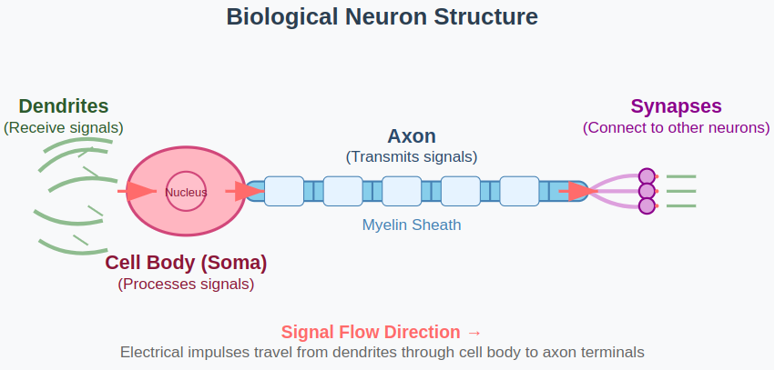
Biological Neuron
Key Components:
Dendrites: Receive signals from other neurons
Cell Body (Soma): Processes incoming signals
Axon: Transmits output signal
Synapses: Connection points between neurons
Notes:
Artificial neural networks (ANNs) are computer systems inspired by biological neural networks in the human brain, using layers of interconnected artificial neurons to process information. They are motivated by the brain's ability to process information through highly parallel computations across many neurons and to learn from experience to recognize patterns and make predictions, though they use mathematical and data-driven processes instead of biological ones.
Biological motivation for ANNs
Parallel processing: The human brain's massive network of neurons allows for complex decisions to be made quickly through a highly parallel process. ANNs are designed to mimic this by using a large number of interconnected units (artificial neurons) that operate simultaneously.
Learning from data: The brain learns and adapts through experience, and ANNs are designed to do the same by processing large amounts of data to identify patterns and make predictions. The network adjusts the "weights" of its connections to improve its performance over time.
Distributed representations: The brain doesn't store information in a single location. Instead, representations are distributed across many neurons. ANNs also use this principle, where a concept or pattern is represented by the pattern of activations across many artificial neurons.Robustness: The brain can often tolerate damage to some neurons without a complete loss of function. Similarly, ANNs can be robust to the failure of some of their processing elements because the information is processed in a distributed manner.
How ANNs mimic the brain
Biological neurons: Biological neurons receive signals through dendrites, process them in the cell body, and transmit them down the axon to other neurons.
Artificial neurons (nodes): ANNs have input nodes that receive data, hidden layers of processing nodes, and output nodes that produce the final result.
Synapses: The connections between biological neurons are called synapses, which can be strengthened or weakened.
Weights: In an ANN, the connections between artificial neurons have weights that can be adjusted during the learning process. A neuron in one layer receives inputs from the previous layer, multiplies each input by its corresponding weight, and then passes the result to the next layer.
Activation function: A mathematical function is used in each artificial neuron to determine its output based on the sum of its weighted inputs. This is similar to how a biological neuron "fires" when its input reaches a certain threshold

Slide 8
Artificial Neuron

Slide 9
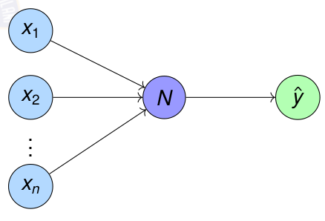
What are Artificial Neurons?
Neuron is a processing element inspired by how the brain works.
Similar to biological neuron, each artificial neuron will be do some computation. Each neuron is interconnected to other neurons.
Similar to brain, the interconnections between neurons store the knowledge it learns. The knowledge is stored as parameters.
Notes:
The artificial neural unit found in the connectionist machine started of as a perceptron. Each neuron will do the computation, which we call as weighted sum. This may be given out as output directly, or we made apply additional processing on the weighted sum before sending the response. The interconnection among the neural unit will store the knowledge of the world. We call the mechanism for storing the knowledge as parameters or weights.
How ANNs mimic the brain
Biological neurons: Biological neurons receive signals through dendrites, process them in the cell body, and transmit them down the axon to other neurons.
Artificial neurons (nodes): ANNs have input nodes that receive data, hidden layers of processing nodes, and output nodes that produce the final result.
Synapses: The connections between biological neurons are called synapses, which can be strengthened or weakened.
Weights: In an ANN, the connections between artificial neurons have weights that can be adjusted during the learning process. A neuron in one layer receives inputs from the previous layer, multiplies each input by its corresponding weight, and then passes the result to the next layer.
Activation function: A mathematical function is used in each artificial neuron to determine its output based on the sum of its weighted inputs. This is similar to how a biological neuron "fires" when its input reaches a certain threshold

Slide 10
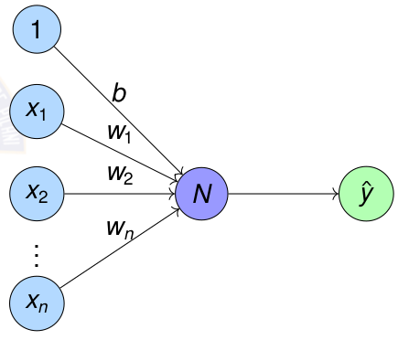
Artificial Neuron N
Processing neuron N performs a very basic computation.
For each feature x_{i} , weight w_{i} shows the importance to the feature
N generates one numerical output ŷ
Notes:
The artificial neural unit found in the connectionist machine started of as a perceptron. Each neuron will do the computation, which we call as weighted sum. This may be given out as output directly, or we made apply additional processing on the weighted sum before sending the response. The interconnection among the neural unit will store the knowledge of the world. We call the mechanism for storing the knowledge as parameters or weights.

Slide 11
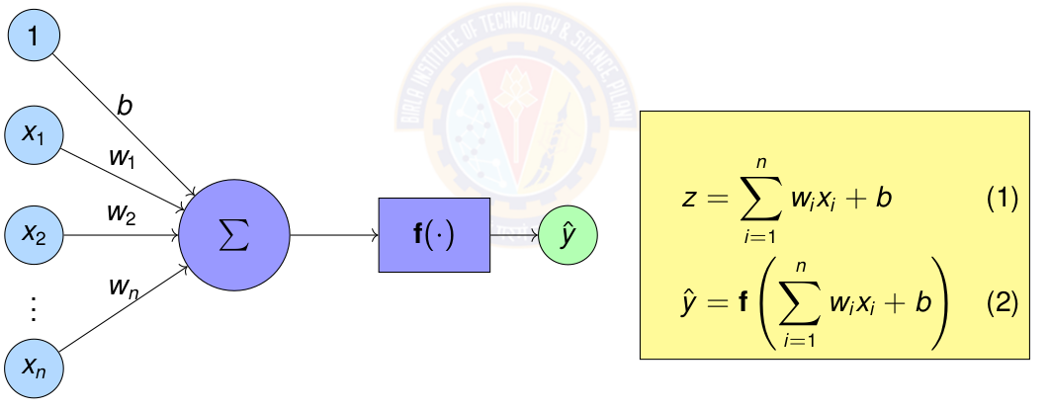
Artificial Neuron – Mathematical Computation
Sum of weights w_{i} times corresponding features x_{i}
Apply activation function f () on the sum.
Notes:
The artificial neural unit found in the connectionist machine started of as a perceptron. Each neuron will do the computation, which we call as weighted sum. This may be given out as output directly, or we made apply additional processing on the weighted sum before sending the response. The interconnection among the neural unit will store the knowledge of the world. We call the mechanism for storing the knowledge as parameters or weights.

Slide 12
Comparison: Biological vs Artificial Neurons
Biological Neuron
Complex biochemical processes
Analog signal processing
Adaptive synaptic strengths
Parallel processing
Learning through experience
Fault tolerant
Artificial Neuron
Simple mathematical model
Digital computation
Adjustable weights
Parallel computation possible
Learning through algorithms
Deterministic behavior

Slide 13
Artificial Neural Network (ANN)

Slide 14
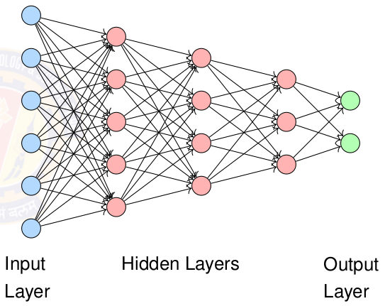
What are Artificial Neural Networks?
Neural Network is a computational model inspired by human brain
Interconnected neurons process information
Interconnection can be forward, recursive or self loop
Learn patterns from data through training
Capable of approximating complex functions

Slide 15
Properties of Artificial Neural Network
Many neuron-like threshold switching units.
Many weighted interconnections among units.
Highly parallel, distributed process.
Emphasis on tuning parameters or weights automatically.

Slide 16
When to consider Artificial Neural Networks?
Input is high-dimensional discrete or real-valued (e.g. raw sensor input).
Possibly noisy data. Data has lots of errors.
Output is discrete or real valued or a vector of values.
Form of target function is unknown.
Human readability, in other words, explainability, of result is unimportant.
Examples:
Speech phoneme recognition
Image classification
Financial prediction

Slide 17
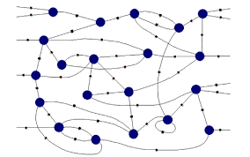
Connectionist Machines
Network of processing elements, called artificial neural neurons neuron
The neurons are interconnected to form a network.
Interconnection can be forward, recursive or self loop
All world knowledge is stored in the connections between these elements.
Neural networks are connectionist machines.
Notes:
The machines that emulate the brain to some extent are called connectionist machines. It is a concept in Artificial intelligence, where each indictila processing element called as neural unit will so some computation. Each unit will receive input from many other units. And each unit will send responses to other neural units. The ideal connectionist machines will have loops and self loops and ll kinds of interconnections imaginable.

Slide 18
Connectionism Principles
Core Ideas:
Intelligence emerges from simple processing neurons
Knowledge is stored in connection weights
Learning modifies connection strengths
Parallel distributed processing
Notes:
The machines that emulate the brain to some extent are called connectionist machines. It is a concept in Artificial intelligence, where each indictila processing element called as neural unit will so some computation. Each unit will receive input from many other units. And each unit will send responses to other neural units. The ideal connectionist machines will have loops and self loops and ll kinds of interconnections imaginable.

Slide 19
Perceptron

Slide 20
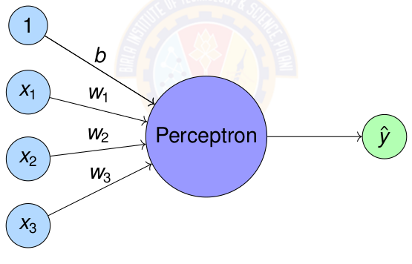
Perceptron
Perceptron = Simplest form of artificial neuron
Perceptron was introduced by Rosenblatt in 1958.
Notes:
A perceptron is a simple machine learning algorithm for supervised learning of binary classifiers, acting as a single-layer neural network. It takes in input data, weights the inputs, and uses an activation function to produce a binary output, deciding whether an input belongs to one of two classes.
Highlight that perceptron will have outputs as +1 and -1 always.

Slide 21
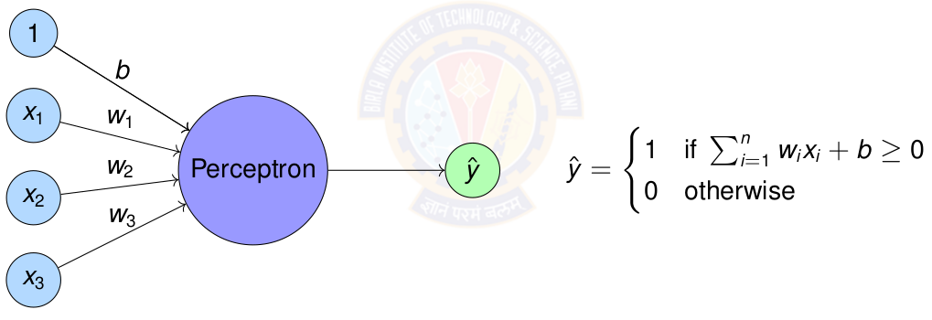
Perceptron
Perceptron = Simplest form of artificial neuron
Notes:
Highlight that perceptron will have outputs as +1 and -1 always.

Slide 22
Perceptron & Logic Gates

Slide 23
Representing Logic Gates using Perceptron
Any linear decision can be represented by a Boolean equation.
The quest is to find out how to represent the above using Perceptron.
For this we test whether each of the logic gates can be represented by a Perceptron.

Slide 24
AND Logic Gate
Question:
How to represent AND gate using a perceptron?
What are the parameters for the AND perceptron?
Data is given below.
A | B | A and B
0 | 0 | 0
0 | 1 | 0
1 | 0 | 0
1 | 1 | 1

Slide 25
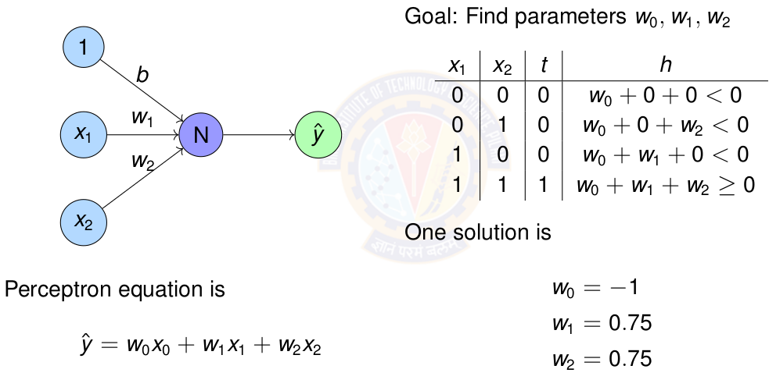
Perceptron for AND gate
Notes:
4 equations and 3 unknown. Easily solved using linear algebra.

Slide 26
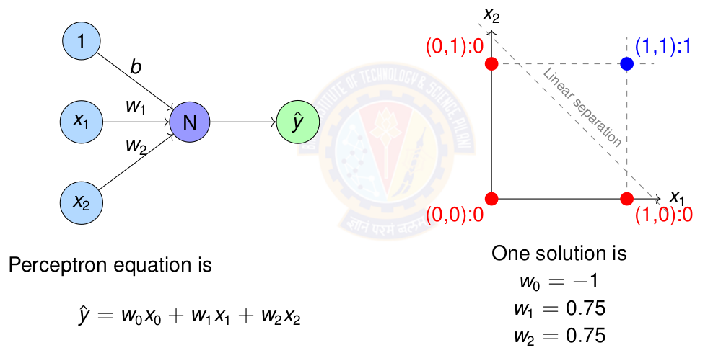
Perceptron for AND gate

Slide 27
OR Logic Gate
Question:
How to represent OR gate using a perceptron?
What are the parameters for the OR perceptron?
Data is given below.
A | B | A or B
0 | 0 | 0
0 | 1 | 1
1 | 0 | 1
1 | 1 | 1

Slide 28
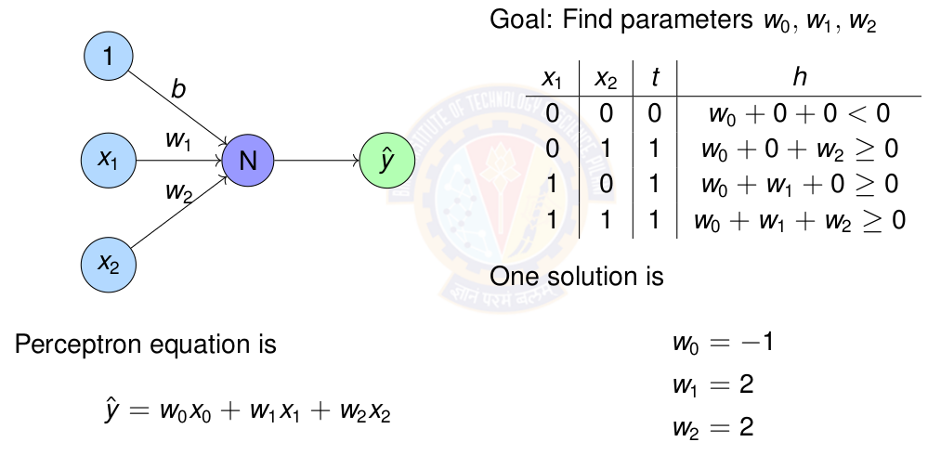
Perceptron for OR gate

Slide 29
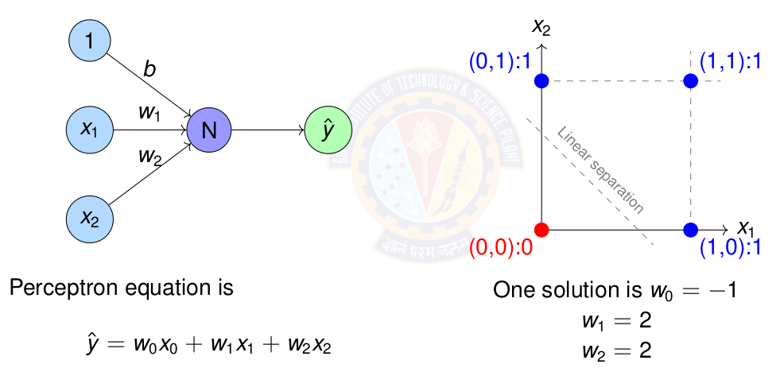
Perceptron for OR gate

Slide 30
Exercise
Represent OR gate using Perceptron. Compute the parameters of the perceptron.
Represent NOR gate using Perceptron. Compute the parameters of the perceptron.
Represent NAND gate using Perceptron. Compute the parameters of the perceptron.
Notes:
Give this as exercise for the students.
NAND Gate in a Perceptron:
A NAND gate outputs O only when all its inputs are 1; otherwise, it outputs 1. To implement this with a perceptron:
Inputs: Let x_{1} and x_{2} be the binary inputs (0 or 1).
Weights: Set the weights, w_{1} and w_{2} to negative values (e.g., -1).
Bias: Set the bias, b, to a positive value (e.g., 1.5).
Activation Function: Use a step function that outputs 1 if the weighted sum plus bias is greater than or equal to a threshold (e.g., 0), and O otherwise.
The perceptron calculates y = Theta(w_{1}*x_{1} + w_{2}*x_{2} + b)
For example, with w_{1} = - 1, w_{2} = - 1 ,b=1.5: If x_{1} = 1 x_{2} = 1 / (- 1) * (1) + (- 1)(1) + 1.5 = - 0.5 Since - 0.5 < 0 the output is 0. For any other input combination (e.g., x_{1} = 0 x_{2} = 0 ): (- 1)(0) + (- 1)(0) + 1.5 = 1.5 Since 1.5 >= 0 the output is 1.
NOR Gate in a Perceptron:
A NOR gate outputs 1 only when all its inputs are 0; otherwise, it outputs O. To implement this with a perceptron:
Inputs: Let x_{1} and x_{2} be the binary inputs (0 or 1).
Weights: Set the weights, w_{1} and w_{2} to negative values (e.g., -1).
Bias: Set the bias, b, to a small positive value (e.g., 0.5).
Activation Function: Use a step function that outputs 1 if the weighted sum plus bias is greater than or equal to a threshold (e.g., 0), and O otherwise.
The perceptron calculates y = Theta(w_{1}*x_{1} + w_{2}*x_{2} + b)
For example, with w_{1} = - 1, w_{2} = - 1 ,b=0.5:
If x_{1} = 0 x_{2} = 0 / (- 1) * (0) + (- 1)(0) + 0.5 = 0.5 Since 0.5 >= 0 the output is 1.
For any other input combination (e.g., x_{1} = 1 x_{2} = 0 ): (- 1)(1) + (- 1)(0) + 0.5 = - 0.5 Since - 0.5 < 0 the output is 0.

Slide 31
Perceptron Learning Algorithm

Slide 32
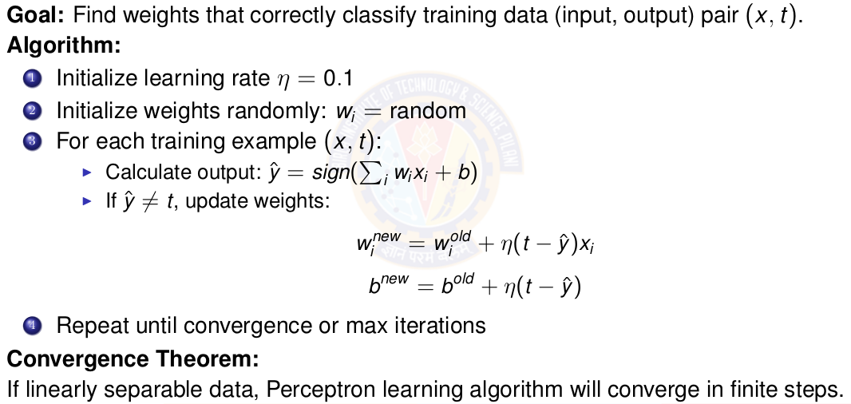
Perceptron Learning Algorithm
Notes:
Definition of learning rate is in next slide

Slide 33
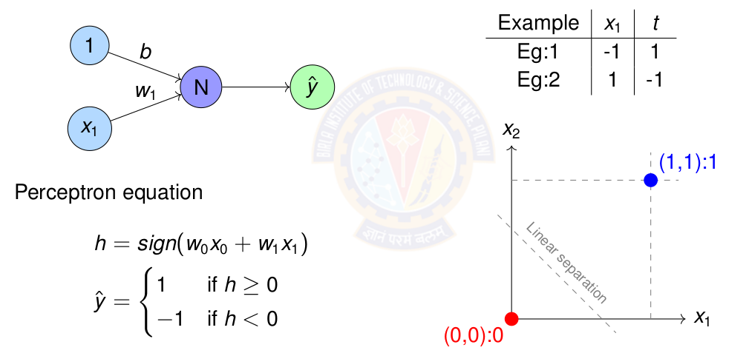
Perceptron Learning for NOT gate
Notes:
Definition of learning rate is in next slide

Slide 34
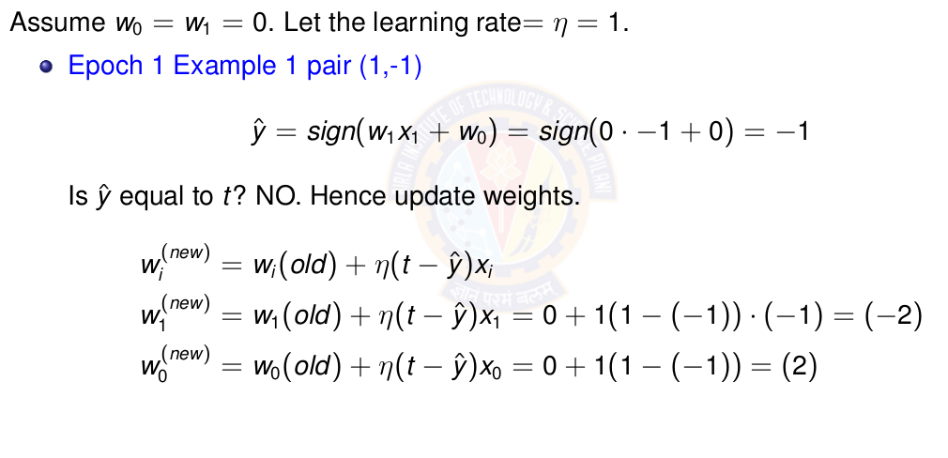
Perceptron Learning for NOT gate
Notes:
Definition of learning rate is in next slide

Slide 35
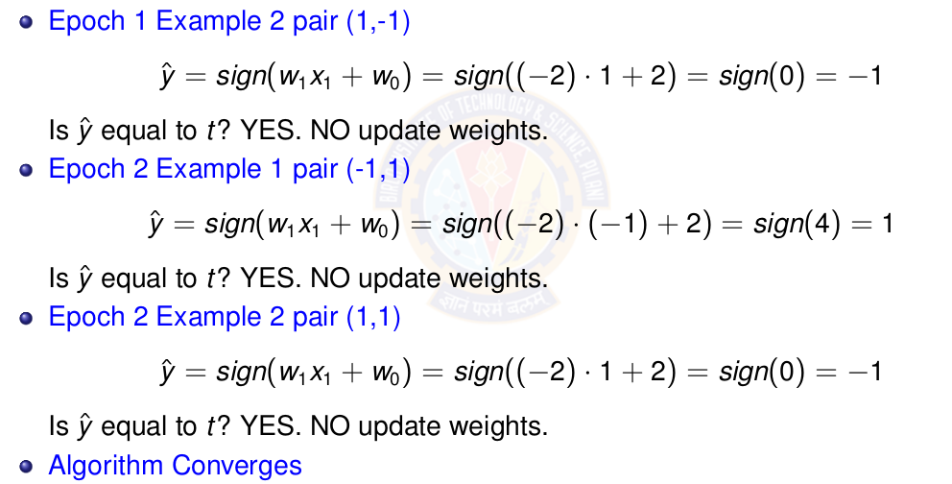
Perceptron Learning for NOT gate
Notes:
Definition of learning rate is in next slide

Slide 36
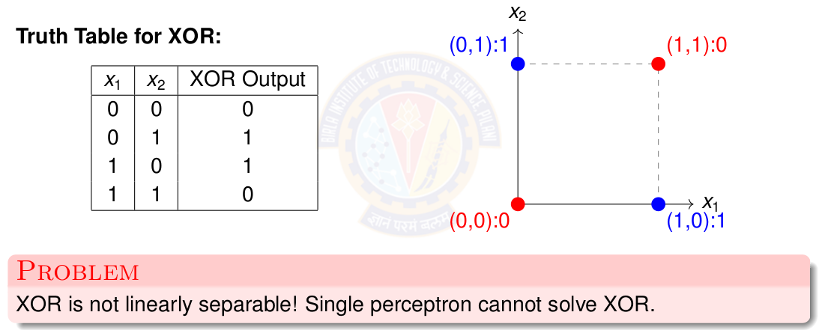
The XOR Problem
Notes:
Definition of learning rate is in next slide

Slide 37
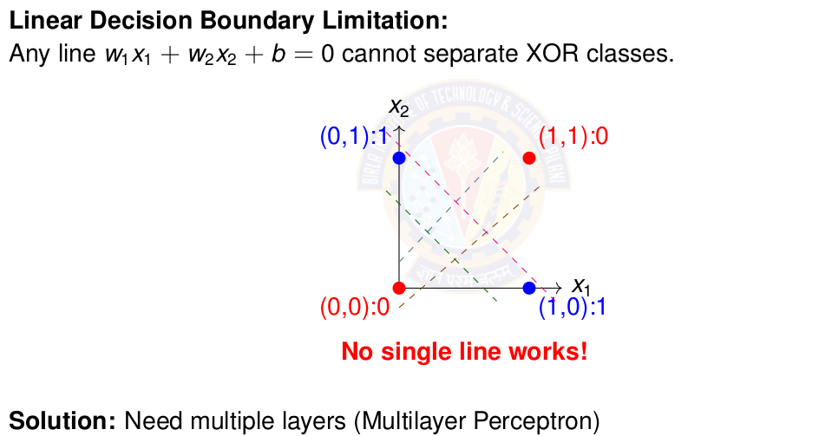
Why Single Perceptron Fails on XOR
Notes:
Definition of learning rate is in next slide

Slide 38
Perceptron Demo Python Code
https://colab.research.google.com/drive/1DUVcOoUIWhl8GQKc6AWR1wi0LaMeNkgD?usp=sharing
Student pl note:
The Python notebook is shared for anyone who has access to the link and the access is restricted to use BITS email id. So pl do not access from non-BITS email id and send requests for access.

Slide 39
Linearly Separable Data

Slide 40
Linearly Separable Data
Two sets data points are separable in a n-dimensional space if they can be separated by an (n-1) dimensional hyperplane.
A straight line can be drawn to separate all the data examples belonging to class +1 from all the examples belonging to the class -1. Then the two-dimensional data are clearly linearly separable.
An infinite number of straight lines can be drawn to separate the class +1 from the class -1.
Notes:
Our aim to find the optimal decision boundary that can separate the classes.

Slide 41
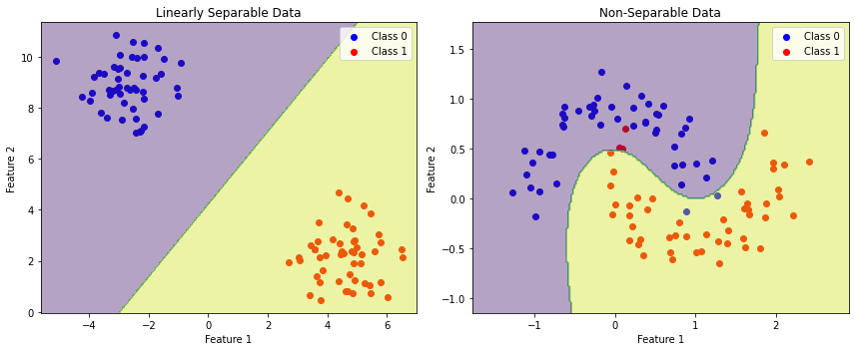
Linearly vs Non-Linearly Separable Data
Notes:
Our aim to find the optimal decision boundary that can separate the classes.

Slide 42
Perceptron for Linearly Separable Data
Data
Truth tables or set of examples
Model
Perceptron
Inputs x are the features or columns
Target output t is the required label
Objective Function
Deviation of desired output or target t and the computed output ŷ
Learning Algorithm
Perceptron Learning algorithm
Challenge
How to learn these n + 1 parameters w₀ , w₁ . w₂ . . . w_{n} ?
Solution
Use Perceptron learning algorithm.
Notes:
THe perceptron can take any number of inputs. Each input connection will have a weight associated with it. The aim is to find the values of these parameters that can draw a decision boundary that will separate the classes. The computation remind the same ie take the sign of the weighted sum and compute output response for each example.

Slide 43
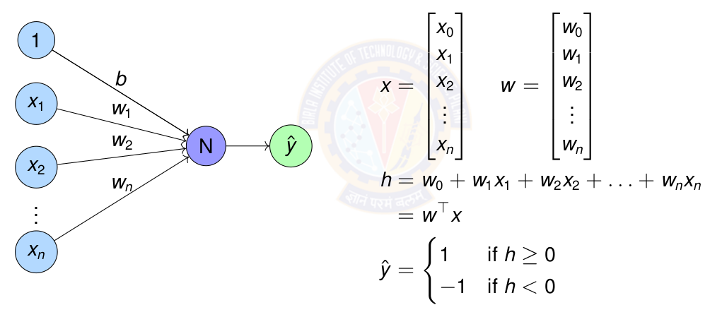
Perceptron for Linearly Separable Data
Notes:
THe perceptron can take any number of inputs. Each input connection will have a weight associated with it. The aim is to find the values of these parameters that can draw a decision boundary that will separate the classes. The computation remind the same ie take the sign of the weighted sum and compute output response for each example.

Slide 44
Exercise
Represent OR gate using Perceptron. Compute the parameters of the perceptron using perceptron learning algorithm.
Represent AND gate using Perceptron. Compute the parameters of the perceptron using perceptron learning algorithm.
Represent NOR gate using Perceptron. Compute the parameters of the perceptron using perceptron learning algorithm.
Represent NAND gate using Perceptron. Compute the parameters of the perceptron using perceptron learning algorithm.
Implement a perceptron for AND and OR gates
Sketch decision boundaries for Single perceptron
Notes:
Give this as exercise for the students.

Slide 45
Key Concepts
Neural Network: Biological inspiration and mathematical models
Perceptron: Simplest neural unit, linear classification, learning algorithm
XOR Problem: Limitation of linear models, need for hidden layers
Learning Paradigms: Supervised, unsupervised, reinforcement learning
Notes:
Give this as exercise for the students.

Slide 46
References
Zhang et al. "Dive into Deep Learning" - Chapter 1 https://d2l.ai/
http://mlsp.cs.cmu.edu/people/rsingh/docs/Chapter1_Introduction.pdf
Goodfellow, Bengio, Courville - "Deep Learning" Chapters 1-6
Rosenblatt, F. (1958) - "The Perceptron: A Probabilistic Model”
Minsky & Papert (1969) - "Perceptrons" (Historical perspective)
Thank You :)

